Slide 1

WAY TO ENTERPRISE
AWS
VTI ACADEMY
Author: duy.nguyenngoc1@vti.com.vn

Slide 2
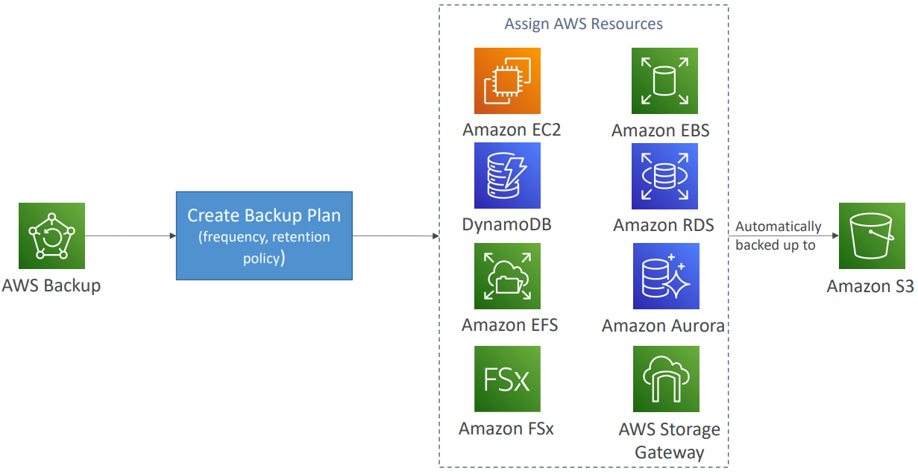
Backup Service
Is service that allows centrally manage and automate backups across AWS services
Supported services: EC2, EBS, EFS, FSx, RDS, Aurora, DynamoDB, Storage Gateway, VMs, ...
Supports cross-region backups
Supports cross-account backups
Supports PITR for supported services
On-Demand and Scheduled backups
Tutorial: https://docs.aws.amazon.com/aws-backup/latest/devguide/whatisbackup.html

Slide 3
Backup Service
Usecases
  Cloud-native backup
  Hybrid data protection
Price: https://aws.amazon.com/backup/pricing

Slide 4
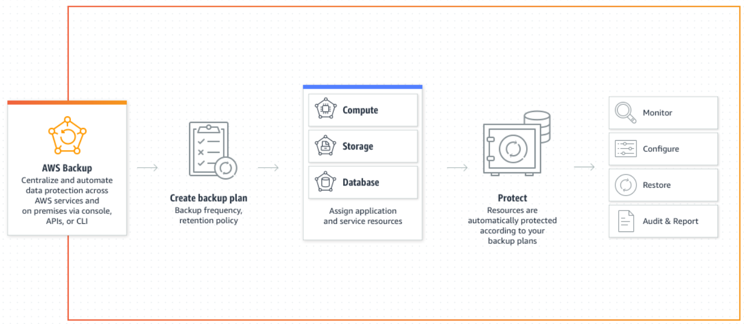
Backup Service
Demo
  https://www.youtube.com/watch?v=tQ0xlEgs0KI
  Cross-Account & Cross-Region: https://www.youtube.com/watch?v=dCy7ixko3tE

Slide 5
Q & A
Copyright © VTI Academy All Rights Reserved

